Slide 1
Project 1 (P162)
Churn probability

Slide 2
Group - 4
Miss . Shobha.M
Ms. Neha Kumari
Ms. Dhanashree Vijaykumar Shitole
Miss. Chadive Pallavi
Ms.Shruti Tanaji Jadhav
Mr. Preetham Shetty
Mr. Keerthi Kumar D Kadlajji

Slide 3
Business Objective
Customer churn is a big problem for telecommunications companies. Indeed, their annual churn rates are usually higher than 10%. For that reason, they develop strategies to keep as many clients as possible. This is a classification project since the variable to be predicted is binary (churn or loyal customer). The goal here is to model churn probability, conditioned on the customer features.

Slide 4
TARGET
Churn is our target variable. It is the one on that determines weather
the client is still in the company or not. (1-Churn, 0-No Churn)

Slide 5
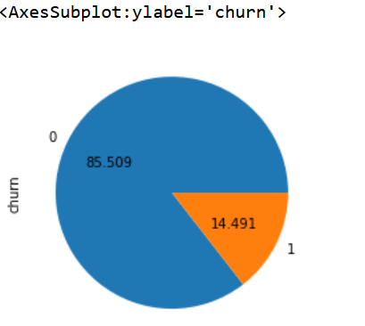
Inference from Pie Cart
There is a churn of 14.4 % and
Loyal customer percentage is around 85 %
Customer 3333

Slide 6
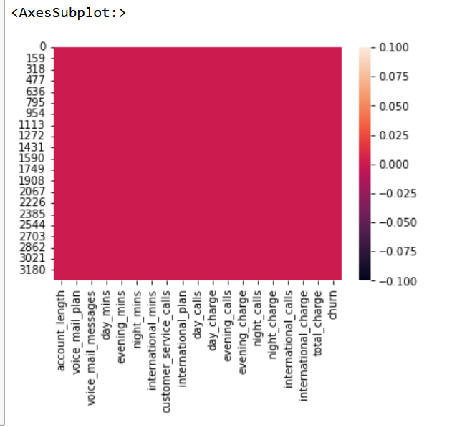
Inference :-
There are Zero missing or Null values in the given data set

Slide 7
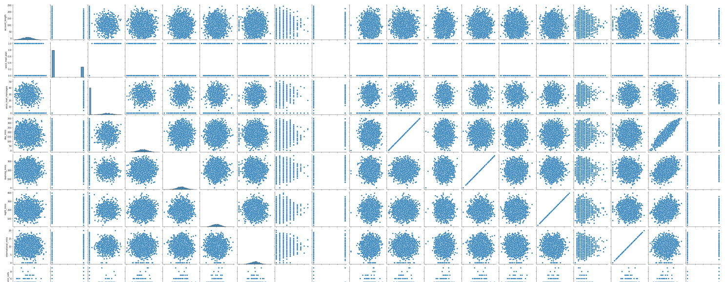
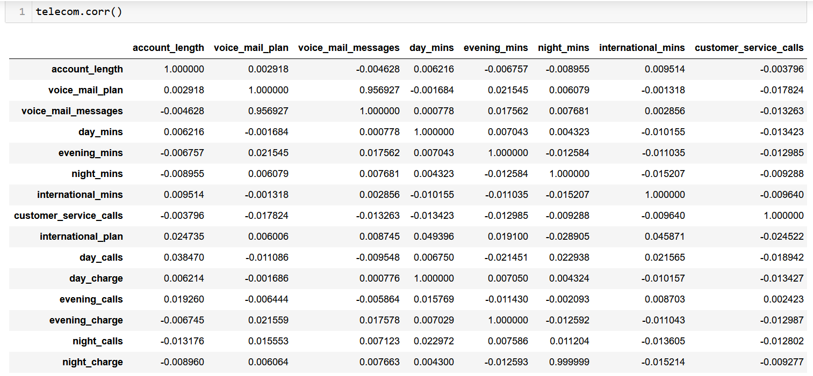
Inference from Pair plot
Below are few High Correlation features when compared with CHURN
customer_service_calls 0.208750
international_plan 0.259852
day_charge 0.205151
total_charge 0.231549
Weak Correlation
evening_calls 0.009233

Slide 8
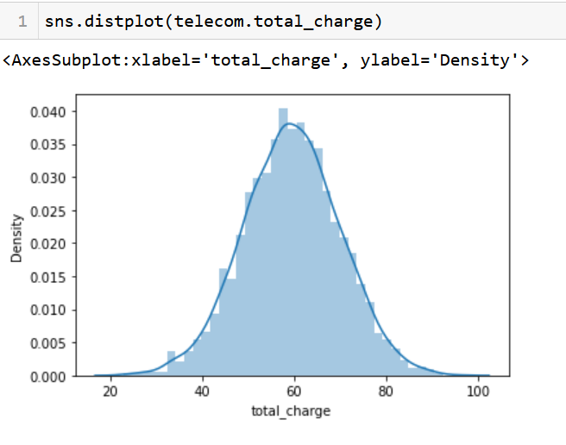
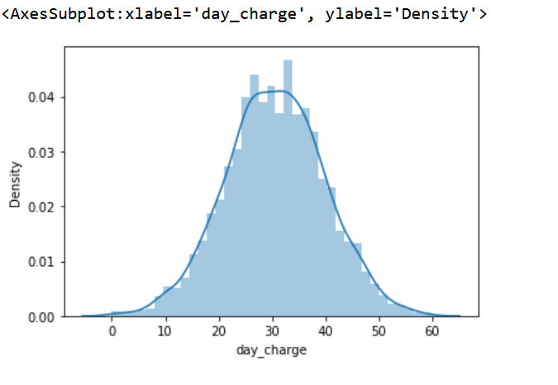
Inference from Distplot
Among all the features
Day_charge and Total_charge look like normally distributed

Slide 9
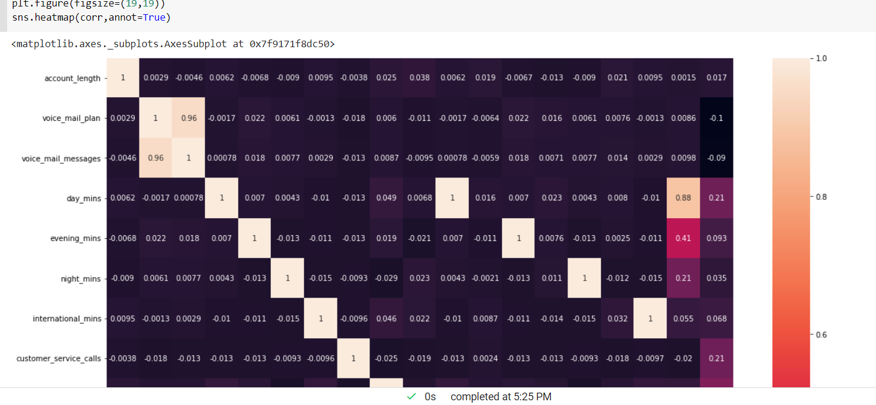
Inference from Heatmp
There are many independent variables that are having high co-relation that need to be treated before model building which can lead to multicollinearity problem.
day_mins | evening_mins | night_mins | international_mins | voice_mail_plan
day_charge | evening_charge | night_charge | international_charge | voice_mail_messages

Slide 10
Agenda 2
–
Model Building

Slide 11
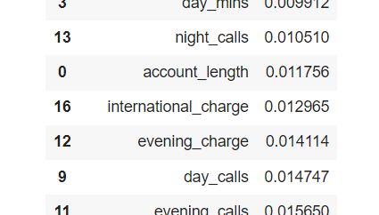
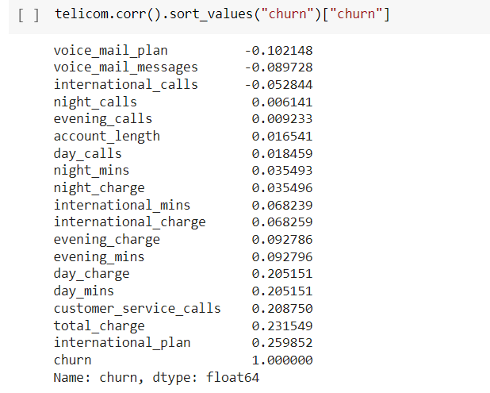
Feature Engineering Using
Correlation

Slide 12
Feature’s used
account_length'
'voice_mail_messages'
'customer_service_calls'
'international_plan'
'day_calls'
'day_charge'
'evening_calls'
'evening_charge'
'night_calls'
'night_charge'
'international_calls'
'international_charge'
'total_charge'
Model Building
Feature’s Dropped
'day_mins'
'evening_mins'
'evening_mins'
'night_mins'
'international_mins'
'voice_mail_plan'
Feature's that we are considering for the model building after EDA

Slide 13
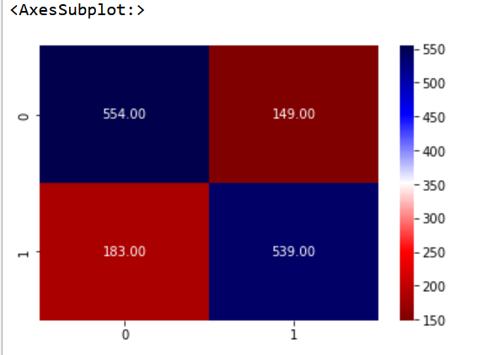
Model 1 - Logistic Regression
Using Logistic Regression with Train and Split method
Accuracy = (554+539)/(554+149+183+539)*100
Accuracy is 76.70%

Slide 14
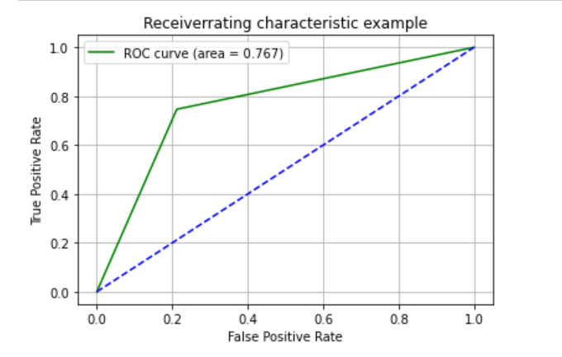
Model 1 - Logistic Regression
ROC Curve
Accuracy = (554+539)/(554+149+183+539)*100
Accuracy is 76.70%

Slide 15
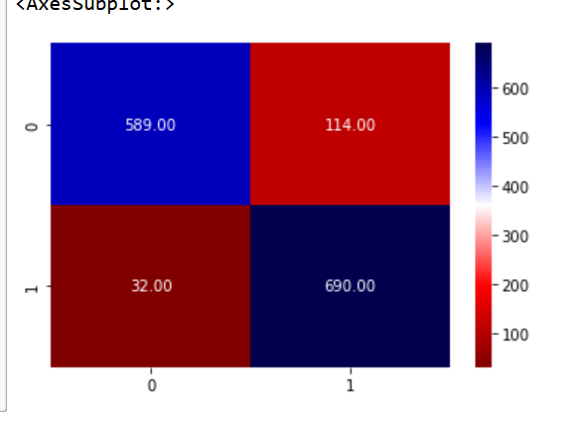
Model 2 - K-Nearest Neighbors Algorithm(KNN)
Using KNN with Train and Split method
Accuracy = (589+690)/(589+114+32+690)*100
Accuracy is 89.75%

Slide 16
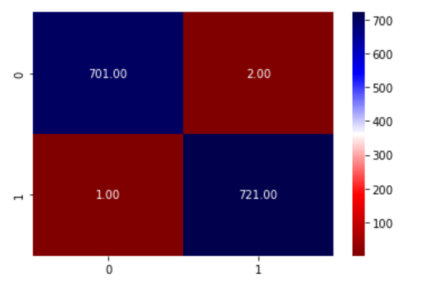
Model 3 - Random Forest Algorithm
Using Random Forest with Train and Split method
Accuracy = (701+721)/(701+2+1+721)*100
Accuracy is 99.79%

Slide 17
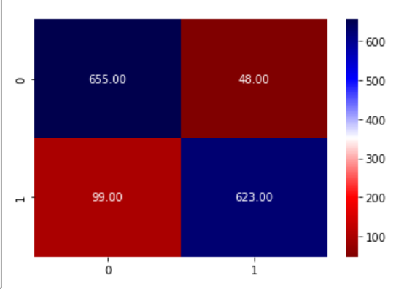
Model 4 - Support Vector Machine Algorithm (SVM)
Using SVM with Train and Split method
Accuracy = (655+623)/(655+48+99+623)*100
Accuracy is 89.68%

Slide 18
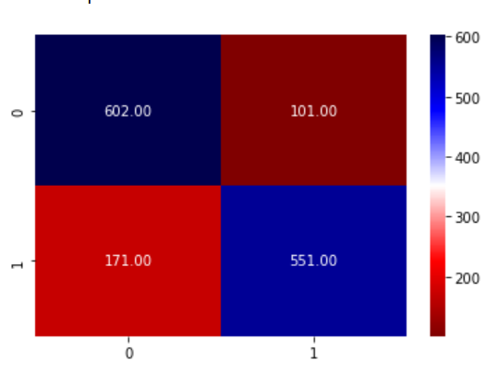
Model 5 - Naive Bayes(NB) Algorithm
Using NB with Train and Split method
Accuracy = (602+551)/(602+101+171+551)*100
Accuracy is 80.91%

Slide 19
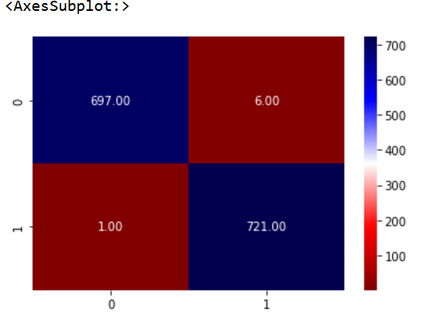
Model 6 - XGBoost Algorithm
Using XGBoost with Train and Split method
Accuracy = (697+721)/(697+6+1+721)*100
Accuracy is 99.51%

Slide 20
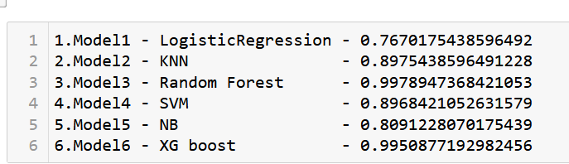
Comparing the Accuracy of all the Models
Random Forest Classifier is at best – 99.79%

Slide 21
HOW TO REDUCE CUSTOMER CHURN
Lean into your best customers.
Be proactive with communication.
Define a roadmap for your new customers.
Offer incentives.
Ask for feedback often.
Analyze churn when it happens.
Stay competitive

Slide 22
CONCLUSION
The importance of this type of research in the telecom market is to help companies make more profit.
It has become known that predicting churn is one of the most important sources of income to Telecom companies.
Hence, this research aimed to build a system that predicts the churn of customers telecom company.

Slide 23
Agenda 3
–
Model Pipeline and Deployment Using Streamlit

Slide 24
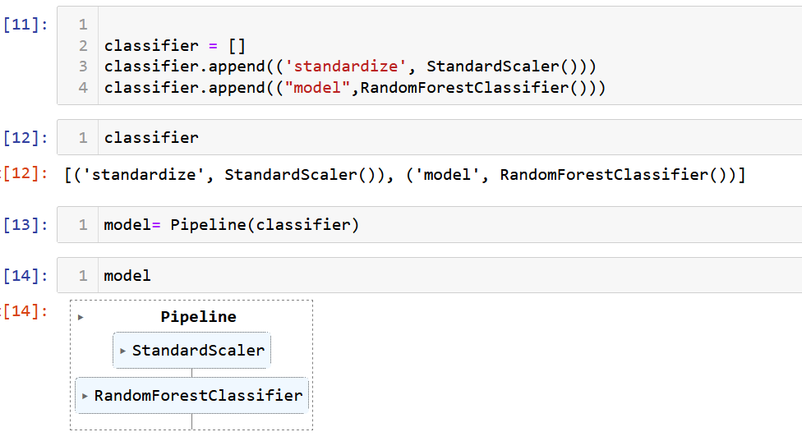
Random Forest Classifier Pipeline
Pipeline StandardScaler and Random Forest

Slide 25
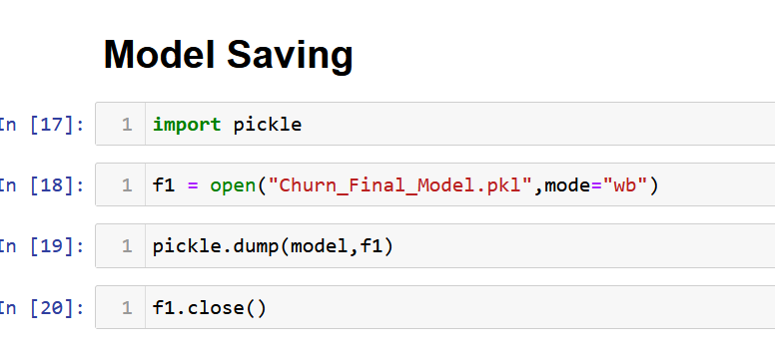
Saving the Model using Pickel
Random Forest Model Saved as
Churn_Final_Model.pkl

Slide 26
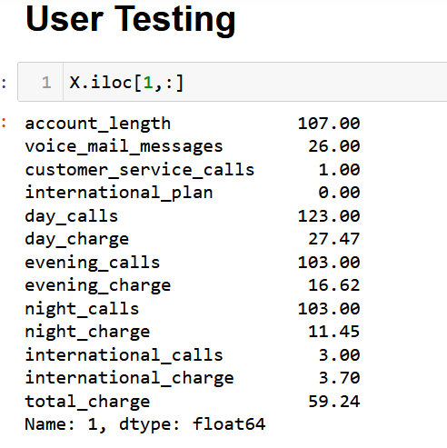
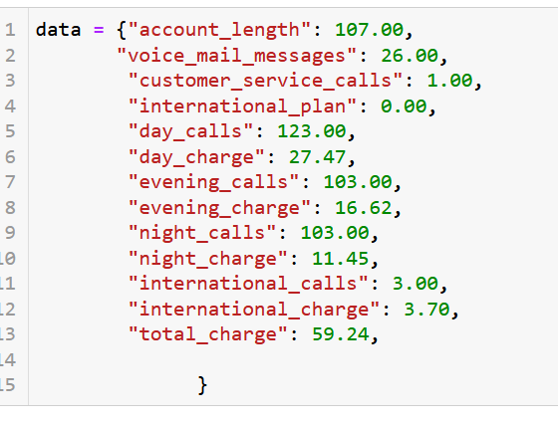
User and Testing
User and Testing –
We have selected for line 1.
If we want to check for any line information.

Slide 27
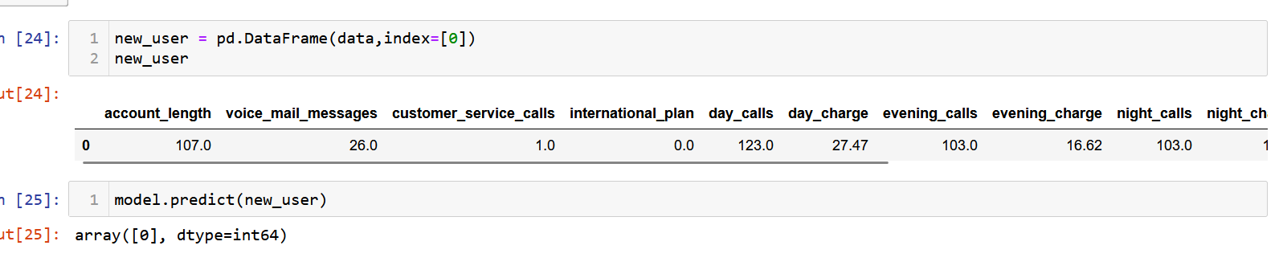
Customer Churn Prediction
We can see above information showing line 1 prediction.
Prediction is showing (0) Customer will not churn.

Slide 28
As per the Accuracy Chart below, We have finalized Random Forest Classifier and Deploying the Model

Slide 29
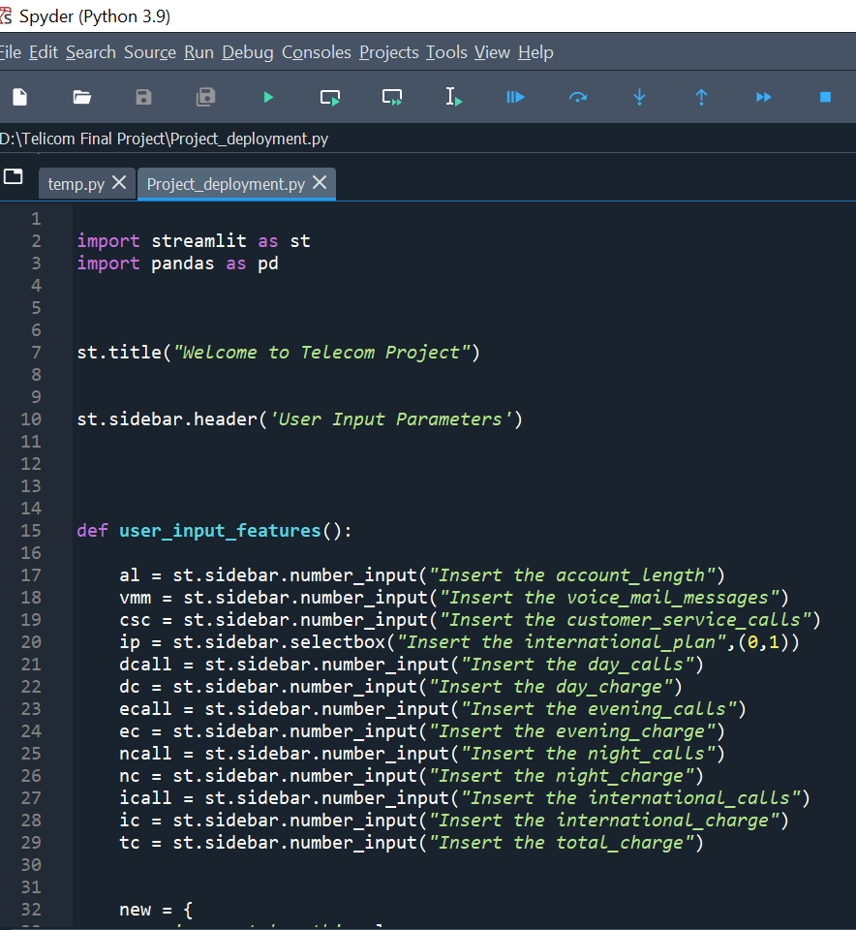
PY File Creation Using Spyder (Python 3.9)
We have created the PY file where we are calling the saved model and the input variables and Predicting based on the User Inputs.

Slide 30
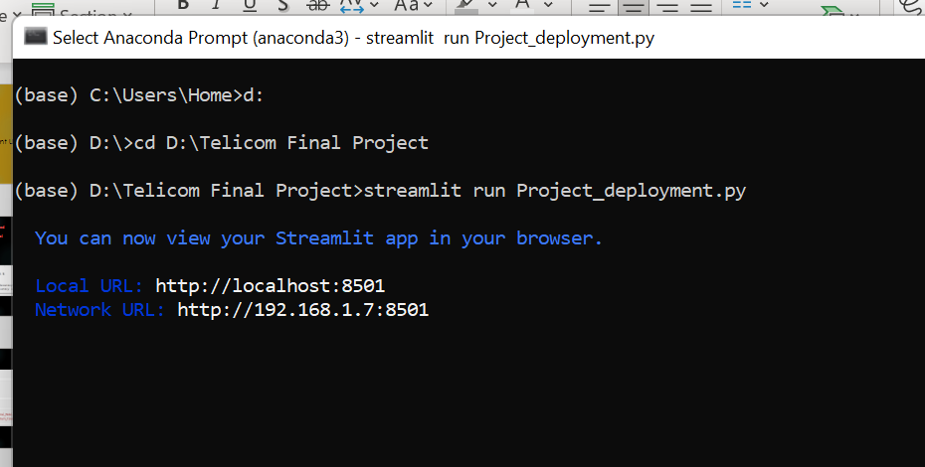
Running the PY file through Anaconda Prompt

Slide 31
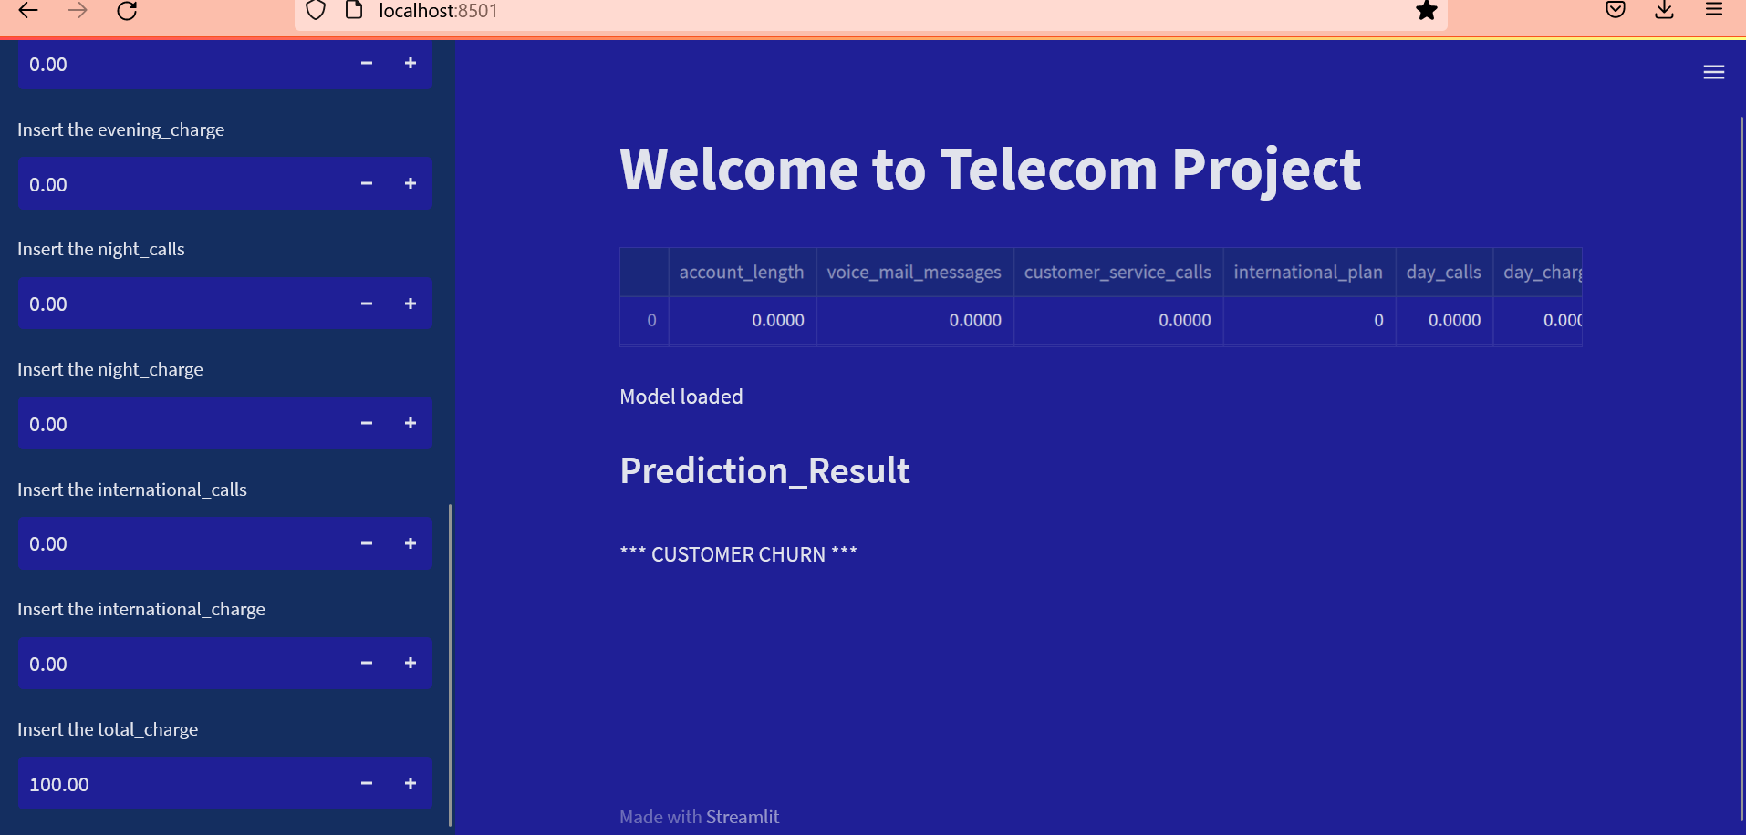
FINAL DEPLOYED MODEL
With Input Variables on left and Predictions and Probability on right

Slide 32
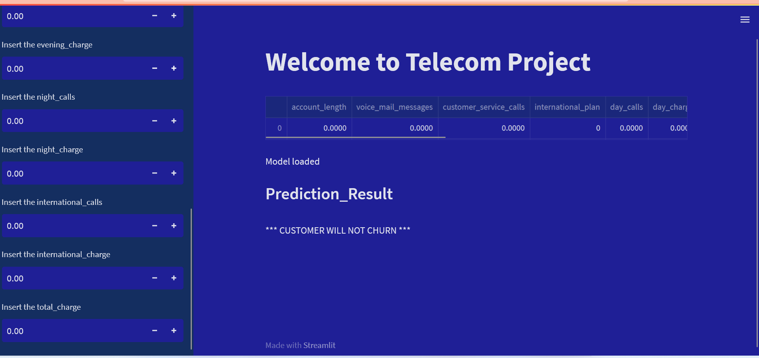
FINAL DEPLOYED MODEL
With Input Variables on left and Predictions and Probability on right

Slide 33
FINAL INFERENCE
Looking at the Model built we could see that
customer_service_calls
total_charge
were largely impacting on the CHURN Probability, hence if Telecommunications companies are monitoring the High Value (total_charge) customers and resolving the issues when they are reaching out to customer service, they can manage the CHURN rate in a controlled manner.

Slide 34


